Slide 1
Reflections on the Lord’s Prayer - a devotion
What does this really mean for us?

Slide 2
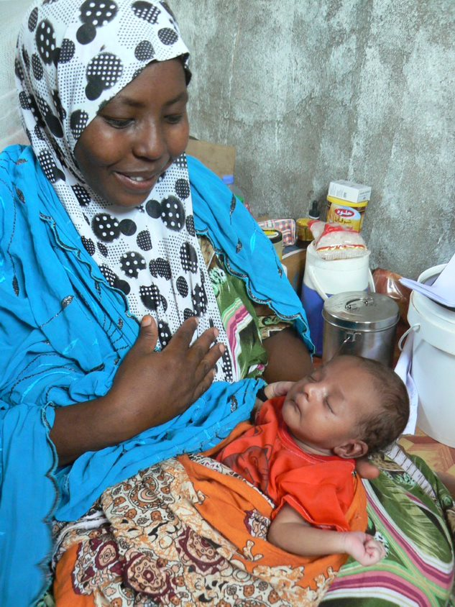
Our Father in heaven
…we are all God’s children

Slide 3
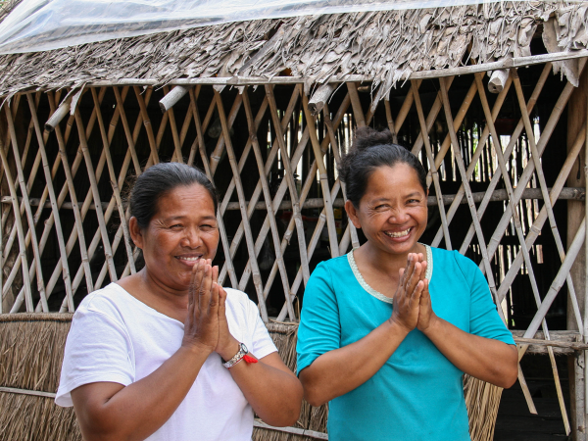
Hallowed be your name
We are in awe of our amazing God

Slide 4
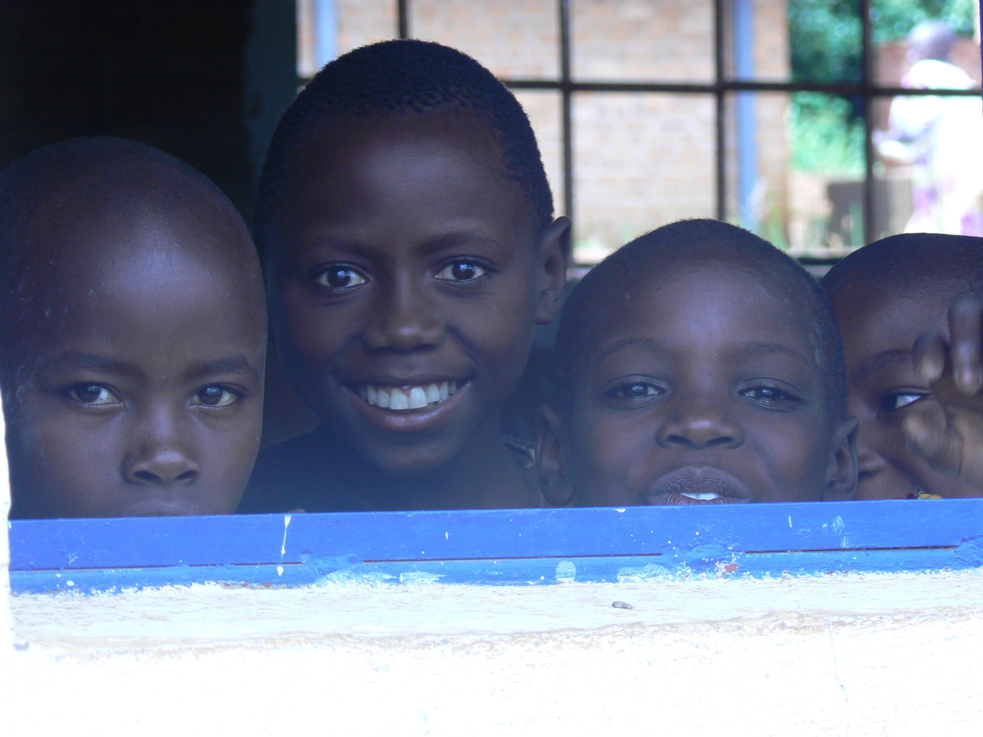
Your Kingdom come
…God is in control, and always will be

Slide 5
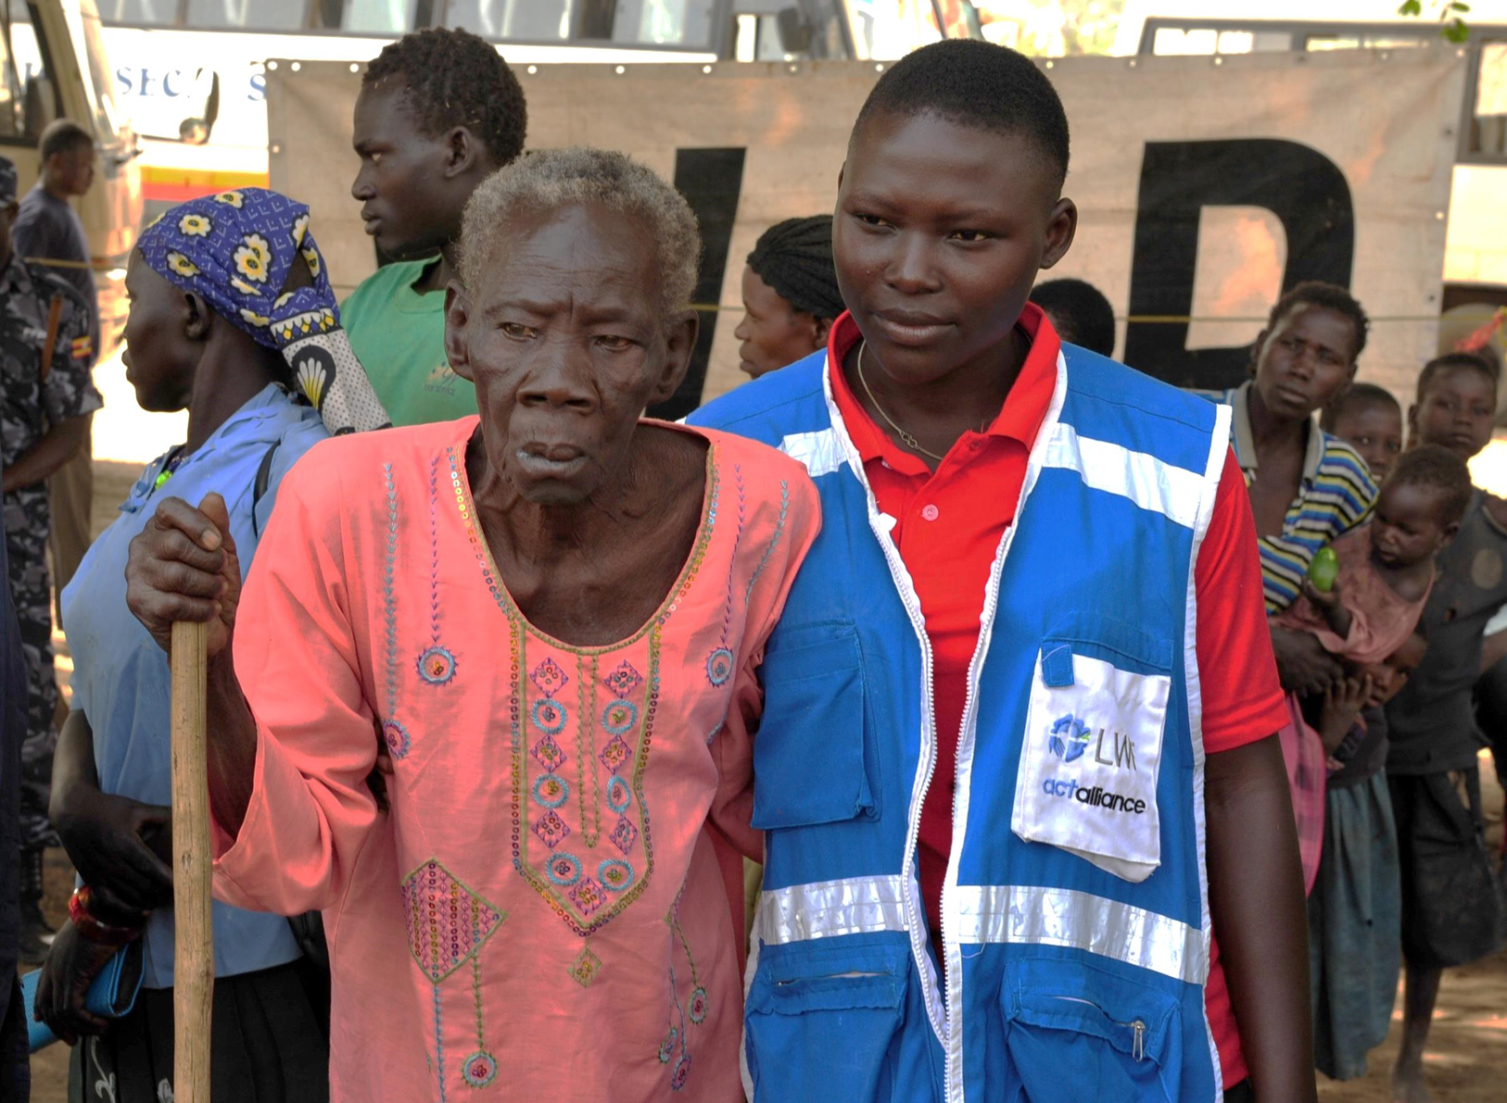
People we work with are showing Jesus' love through their actions. They are bringing faith to life

Slide 6
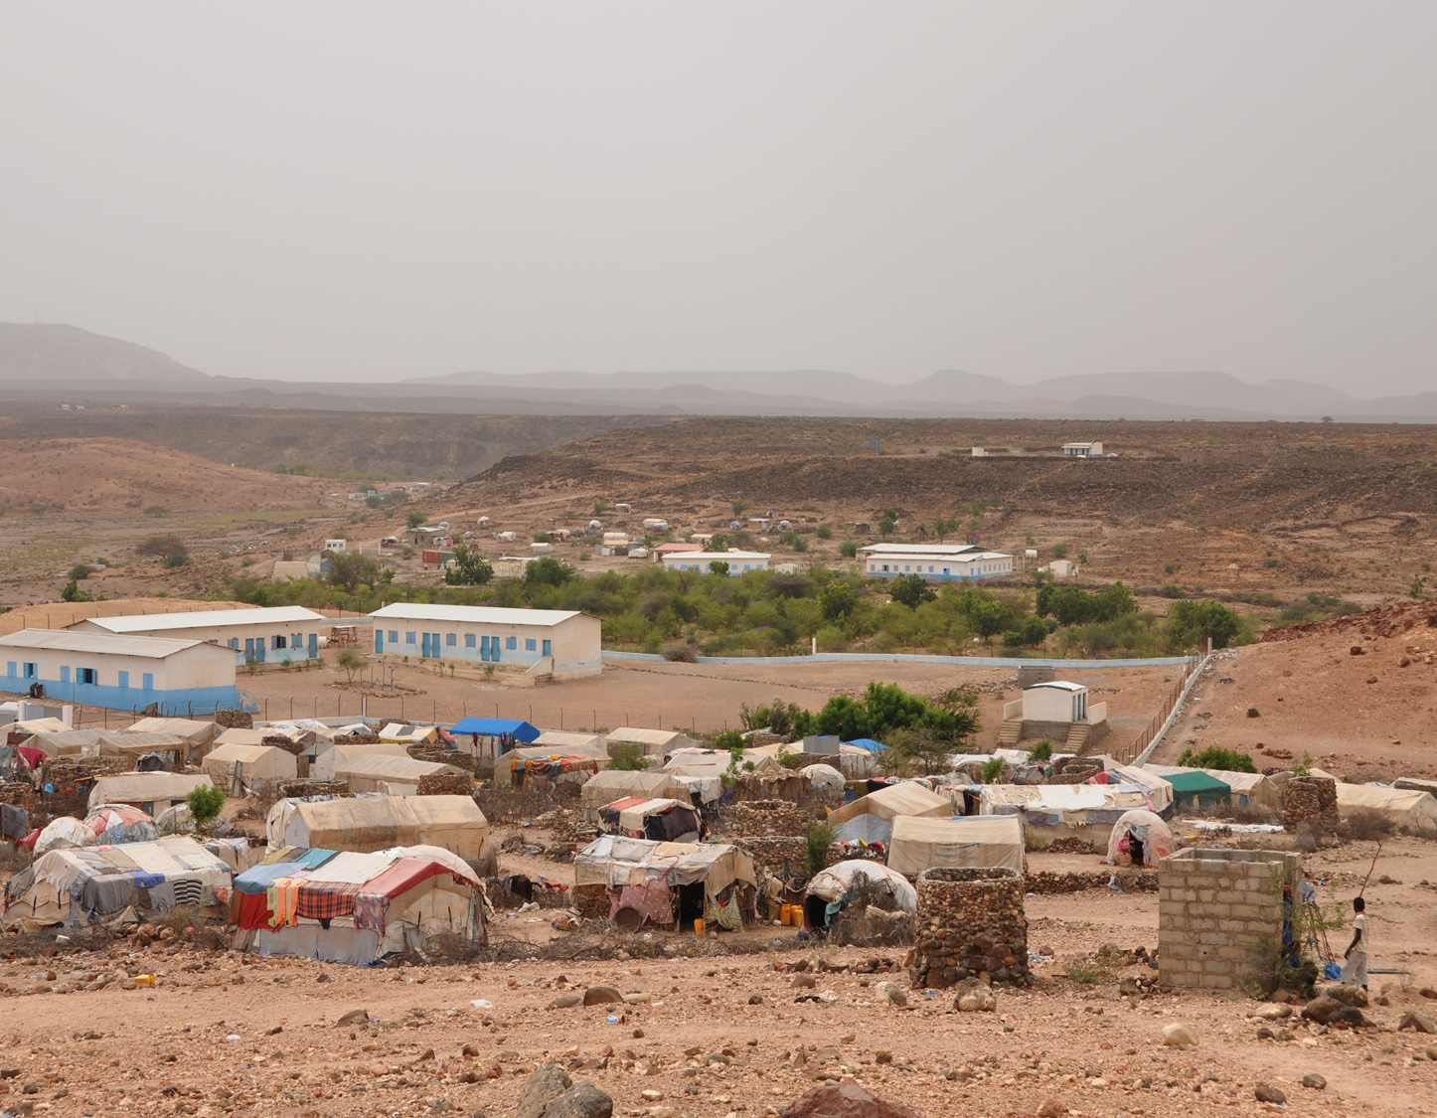
Your will be done, on earth as in heaven
We will do whatever you ask of us

Slide 7
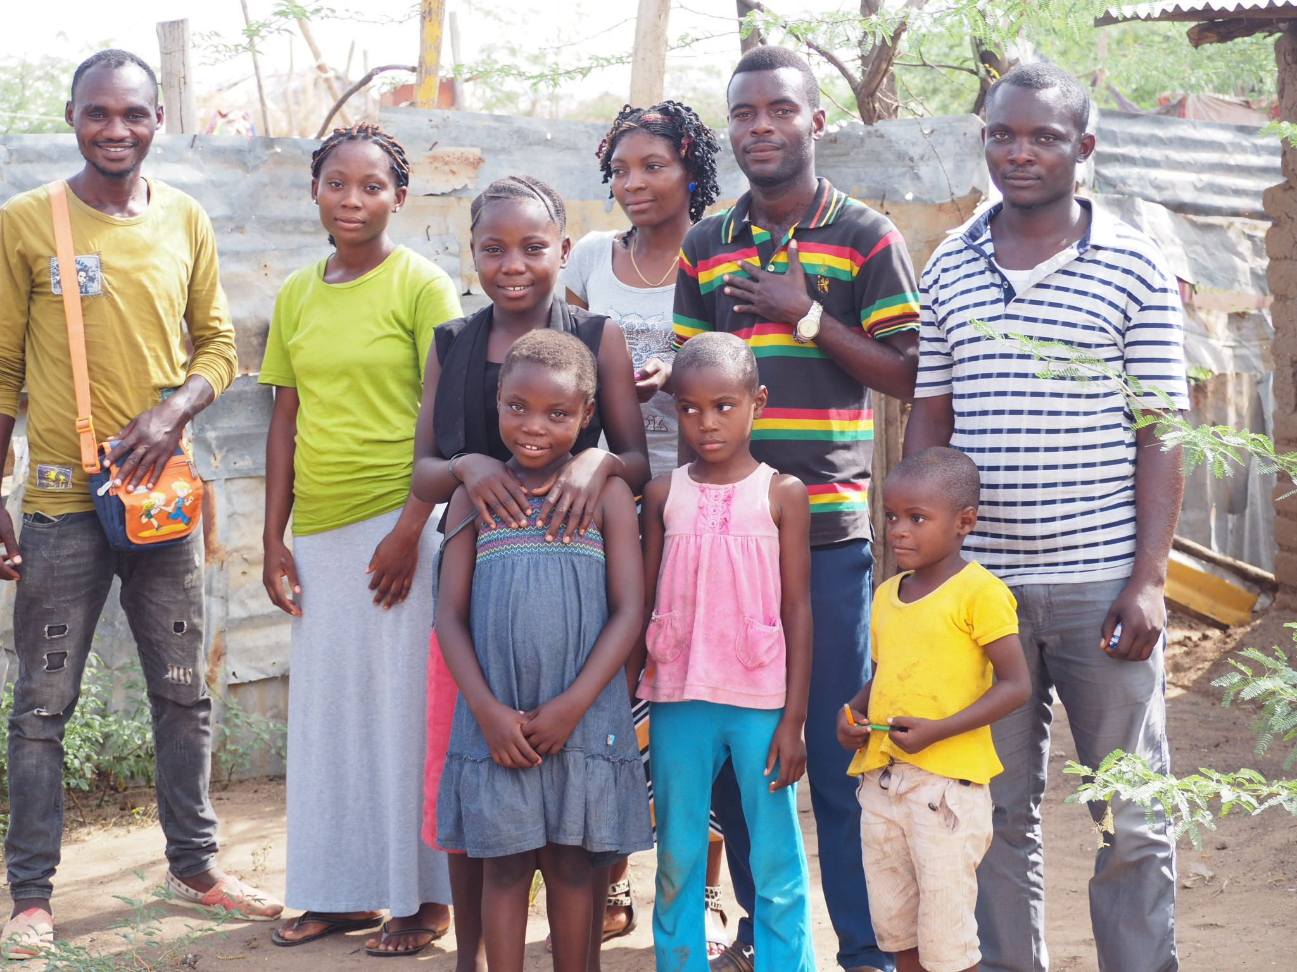
God has shown so much love to us and asks us to show that love to others –

Slide 8
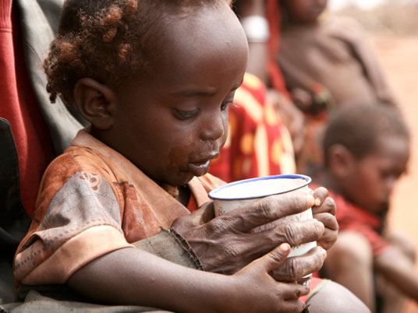
Give us today our daily bread
…We can rely on God to give us everything we need

Slide 9
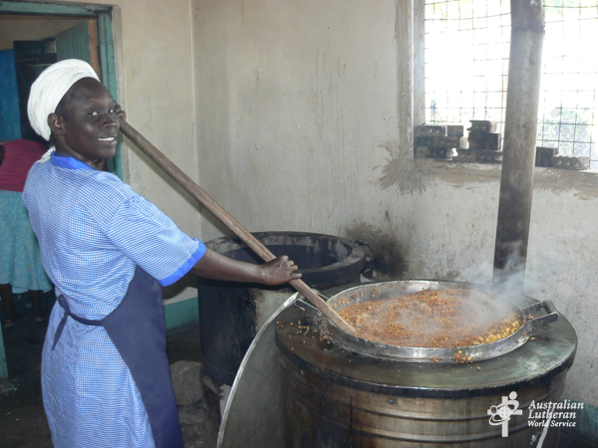
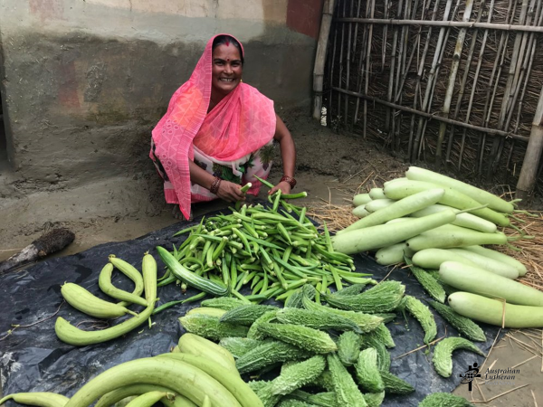
In refugee camps, people are given food.
People are taught what to grow and how to grow it

Slide 10
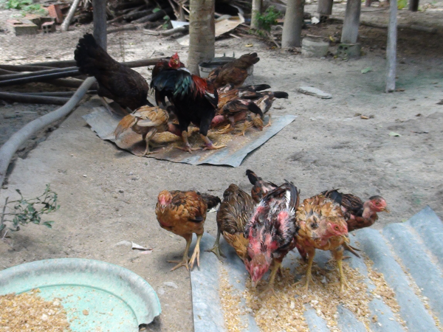
Forgive us our sins
Sorry that we mess up sometimes

Slide 11
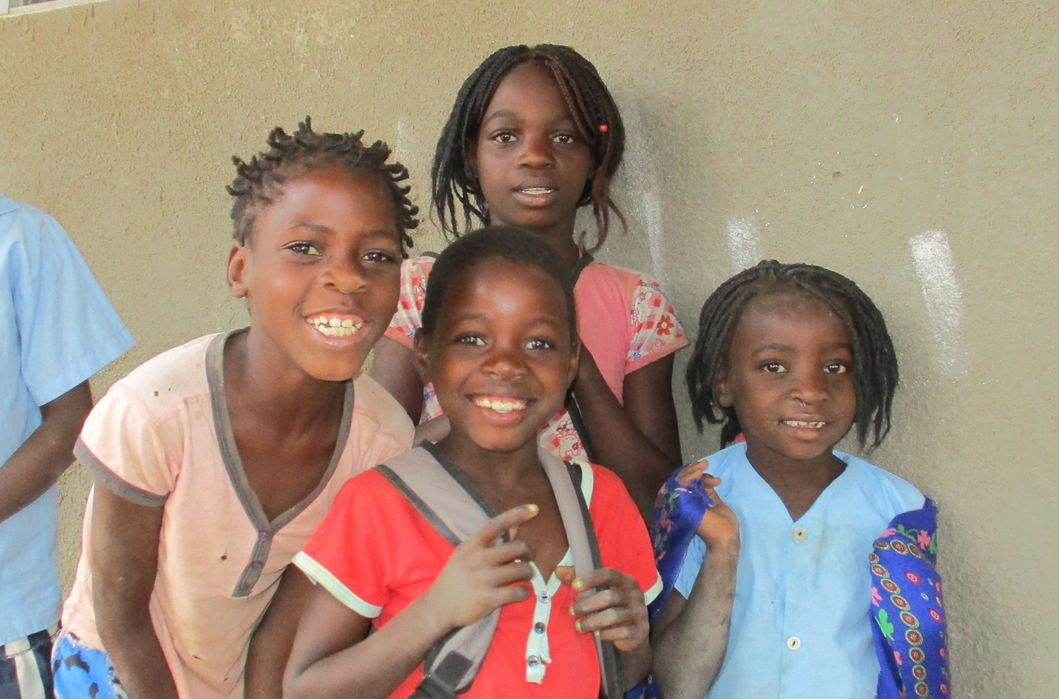
As we forgive those who sin against us
Help us not to hold grudges or judge others

Slide 12
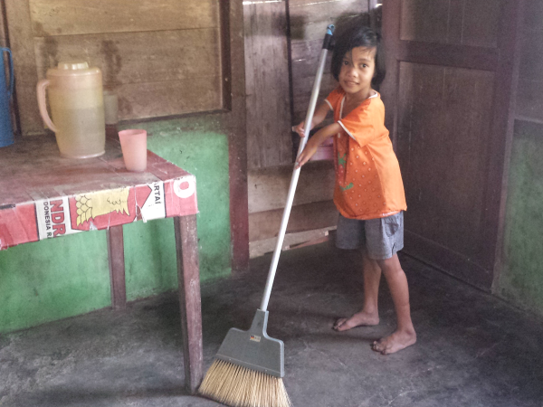
God loves us all – even the most forgotten people who may not have experienced love before

Slide 13
Lead us not into temptation
…Help us to avoid making bad choices or decisions

Slide 14
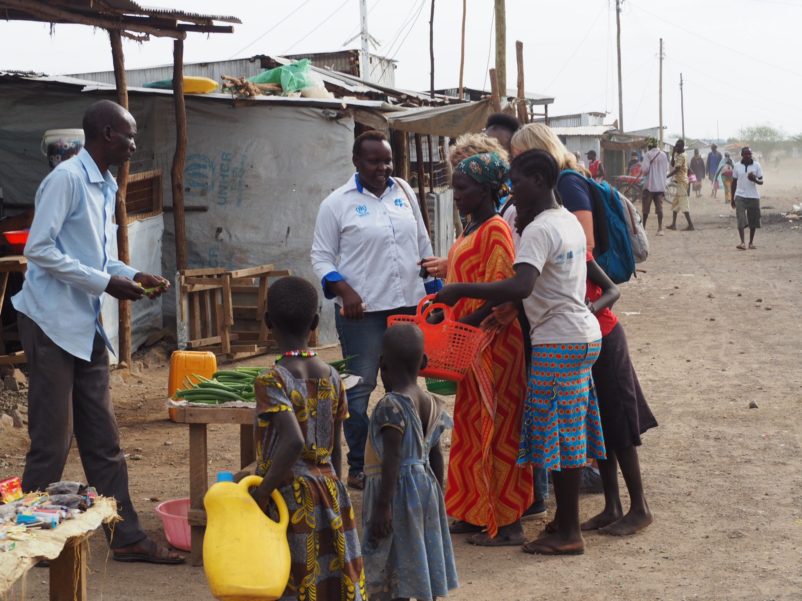
We make so many choices each day, up to 35 000 choices in fact. Or 2000 decisions per hour
or 1 decision every 2 seconds
Do we always make wise choices?
When people are poor, they often don’t have the choices that we do…

Slide 15
But deliver us from evil
Protect us from the bad things in our lives

Slide 16
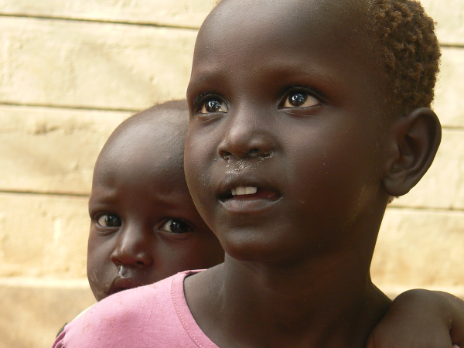
People arrive in refugee camps, often with nothing, after a difficult journey, scared by the violence or conflict.
“when I arrived here I felt safe”

Slide 17
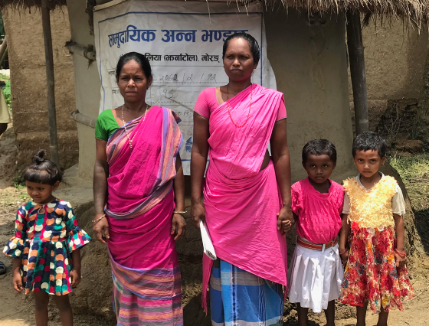
For the kingdom,
You are everywhere, with us, all around us

Slide 18
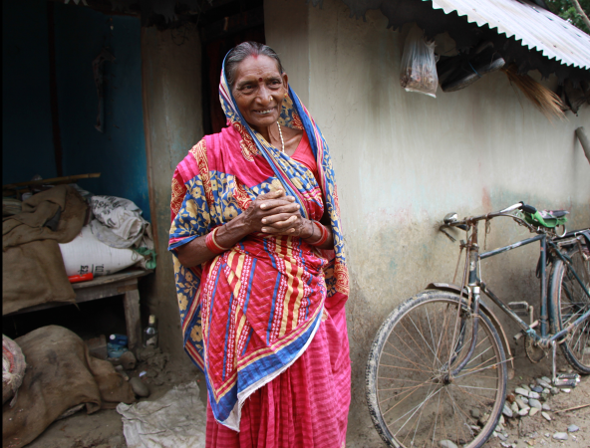
The power
You alone are in control

Slide 19
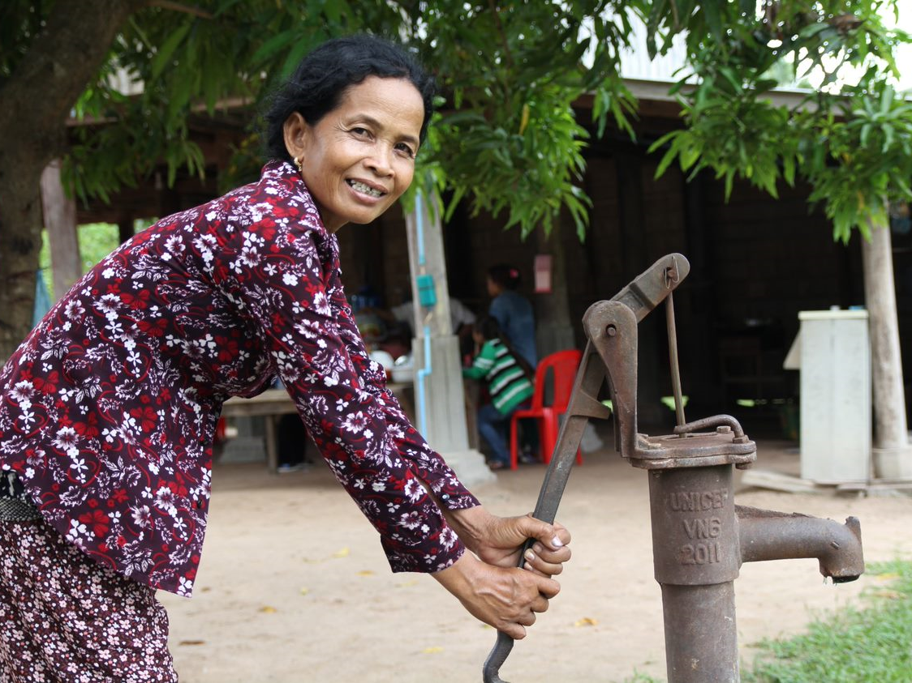
And the glory are yours
You deserve all our
praise and thanks

Slide 20
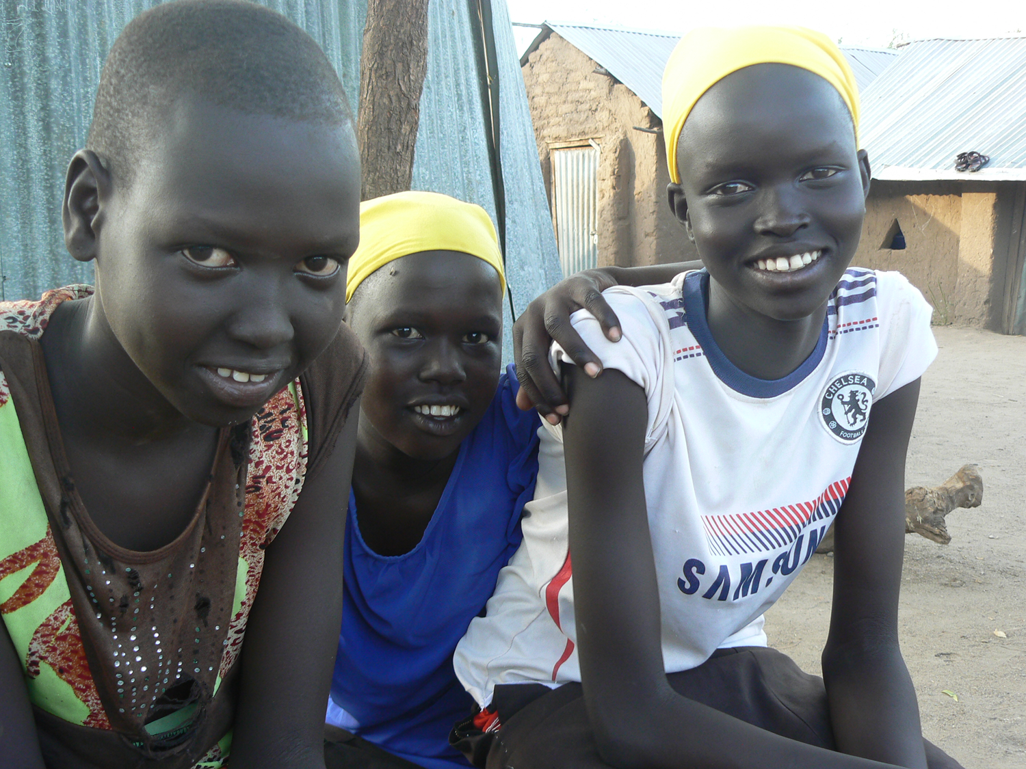
Through ALWS, you help give people a go.
We can show our love for God by showing our love to others.

Slide 21
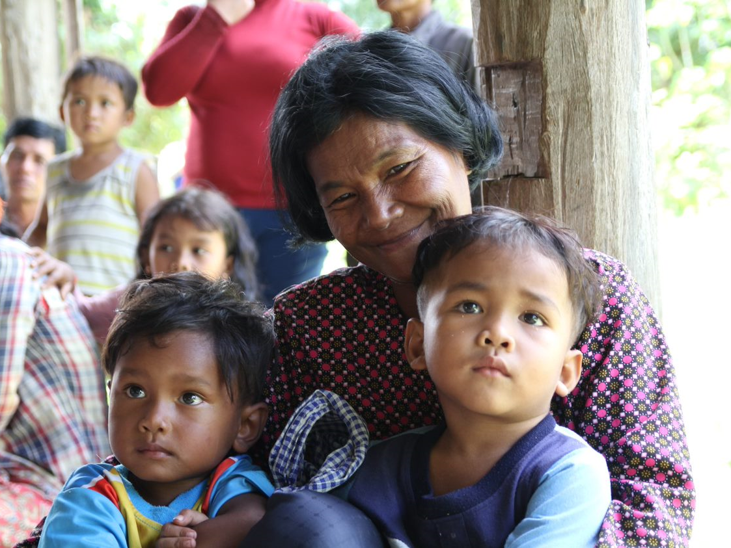
Now and forever,

Slide 22
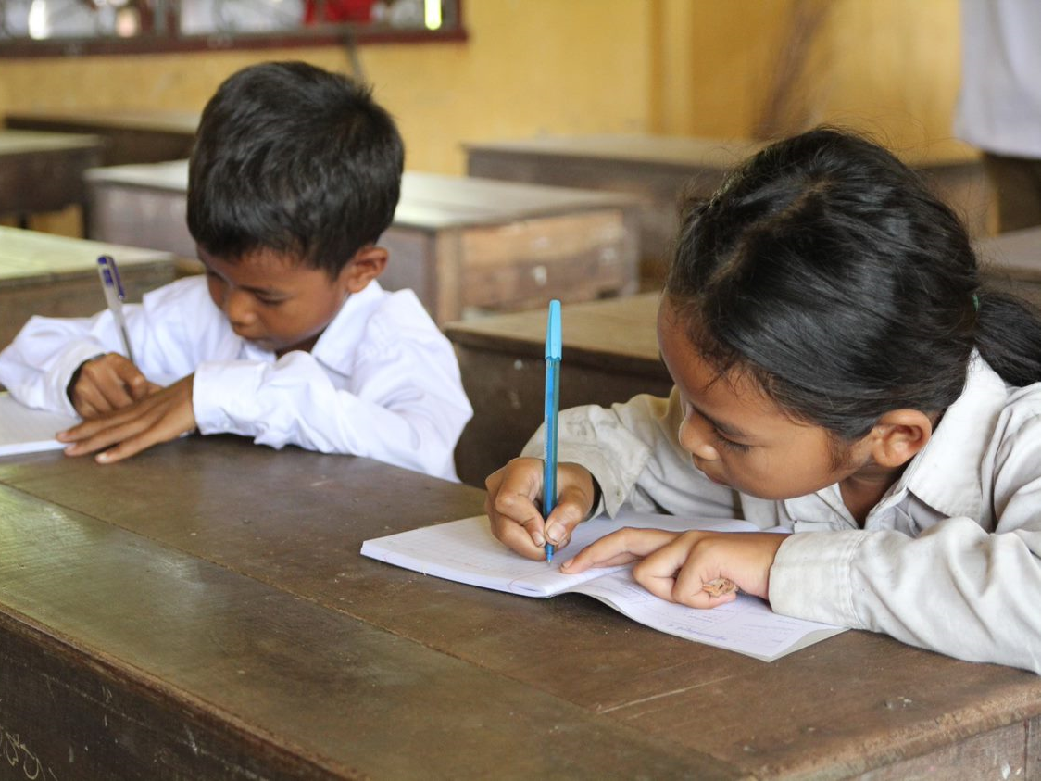
Amen

